Slide 1
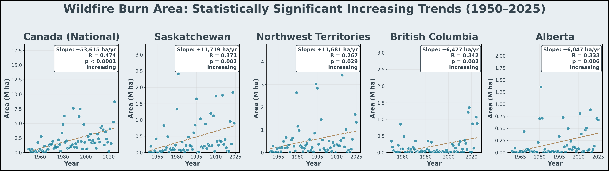
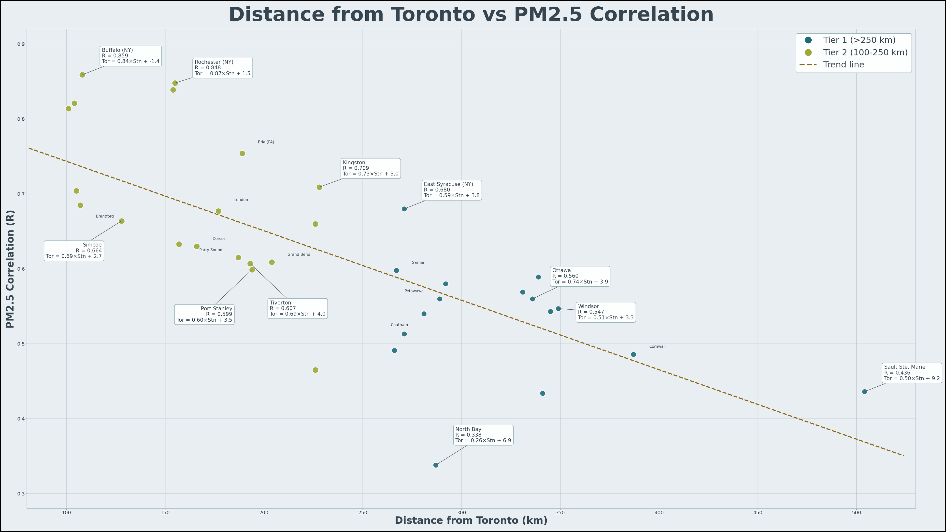
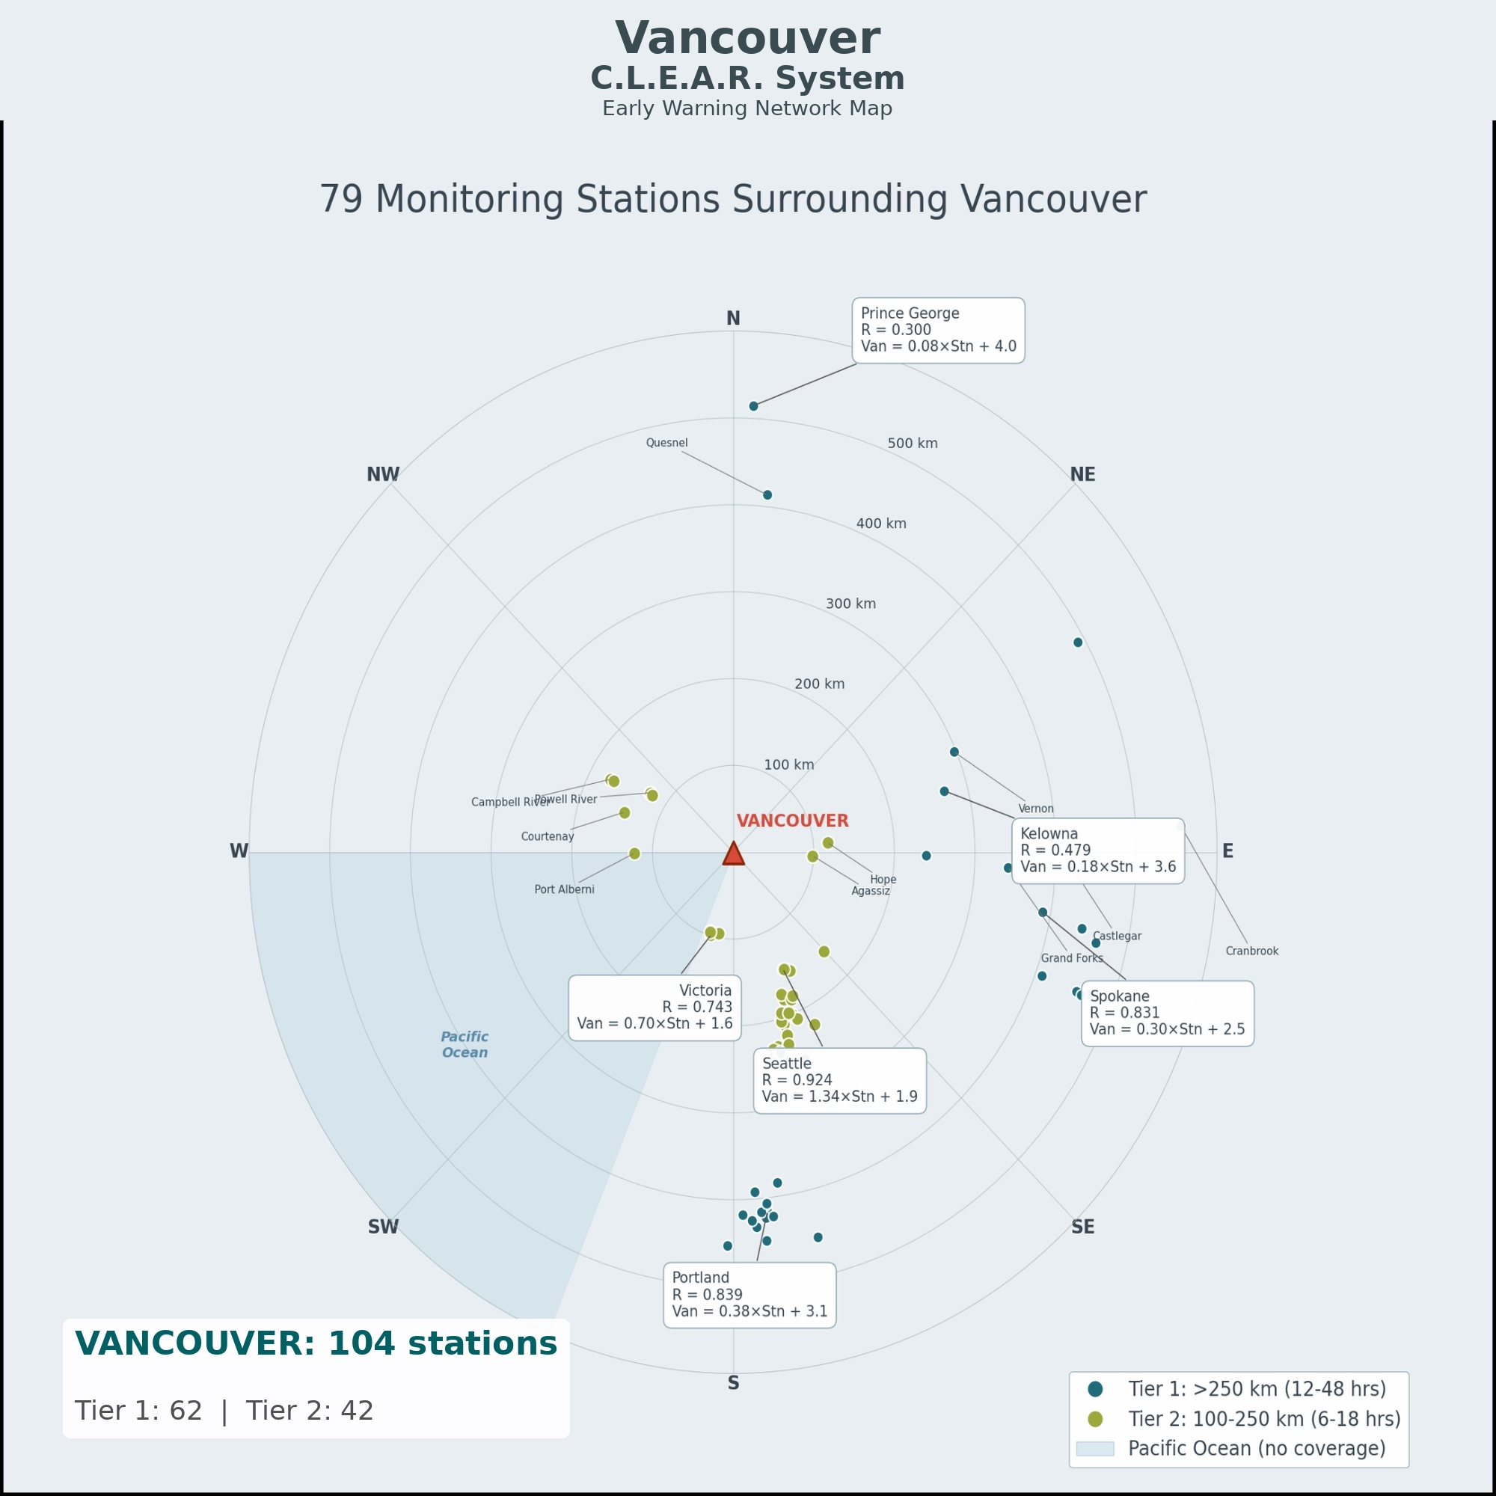
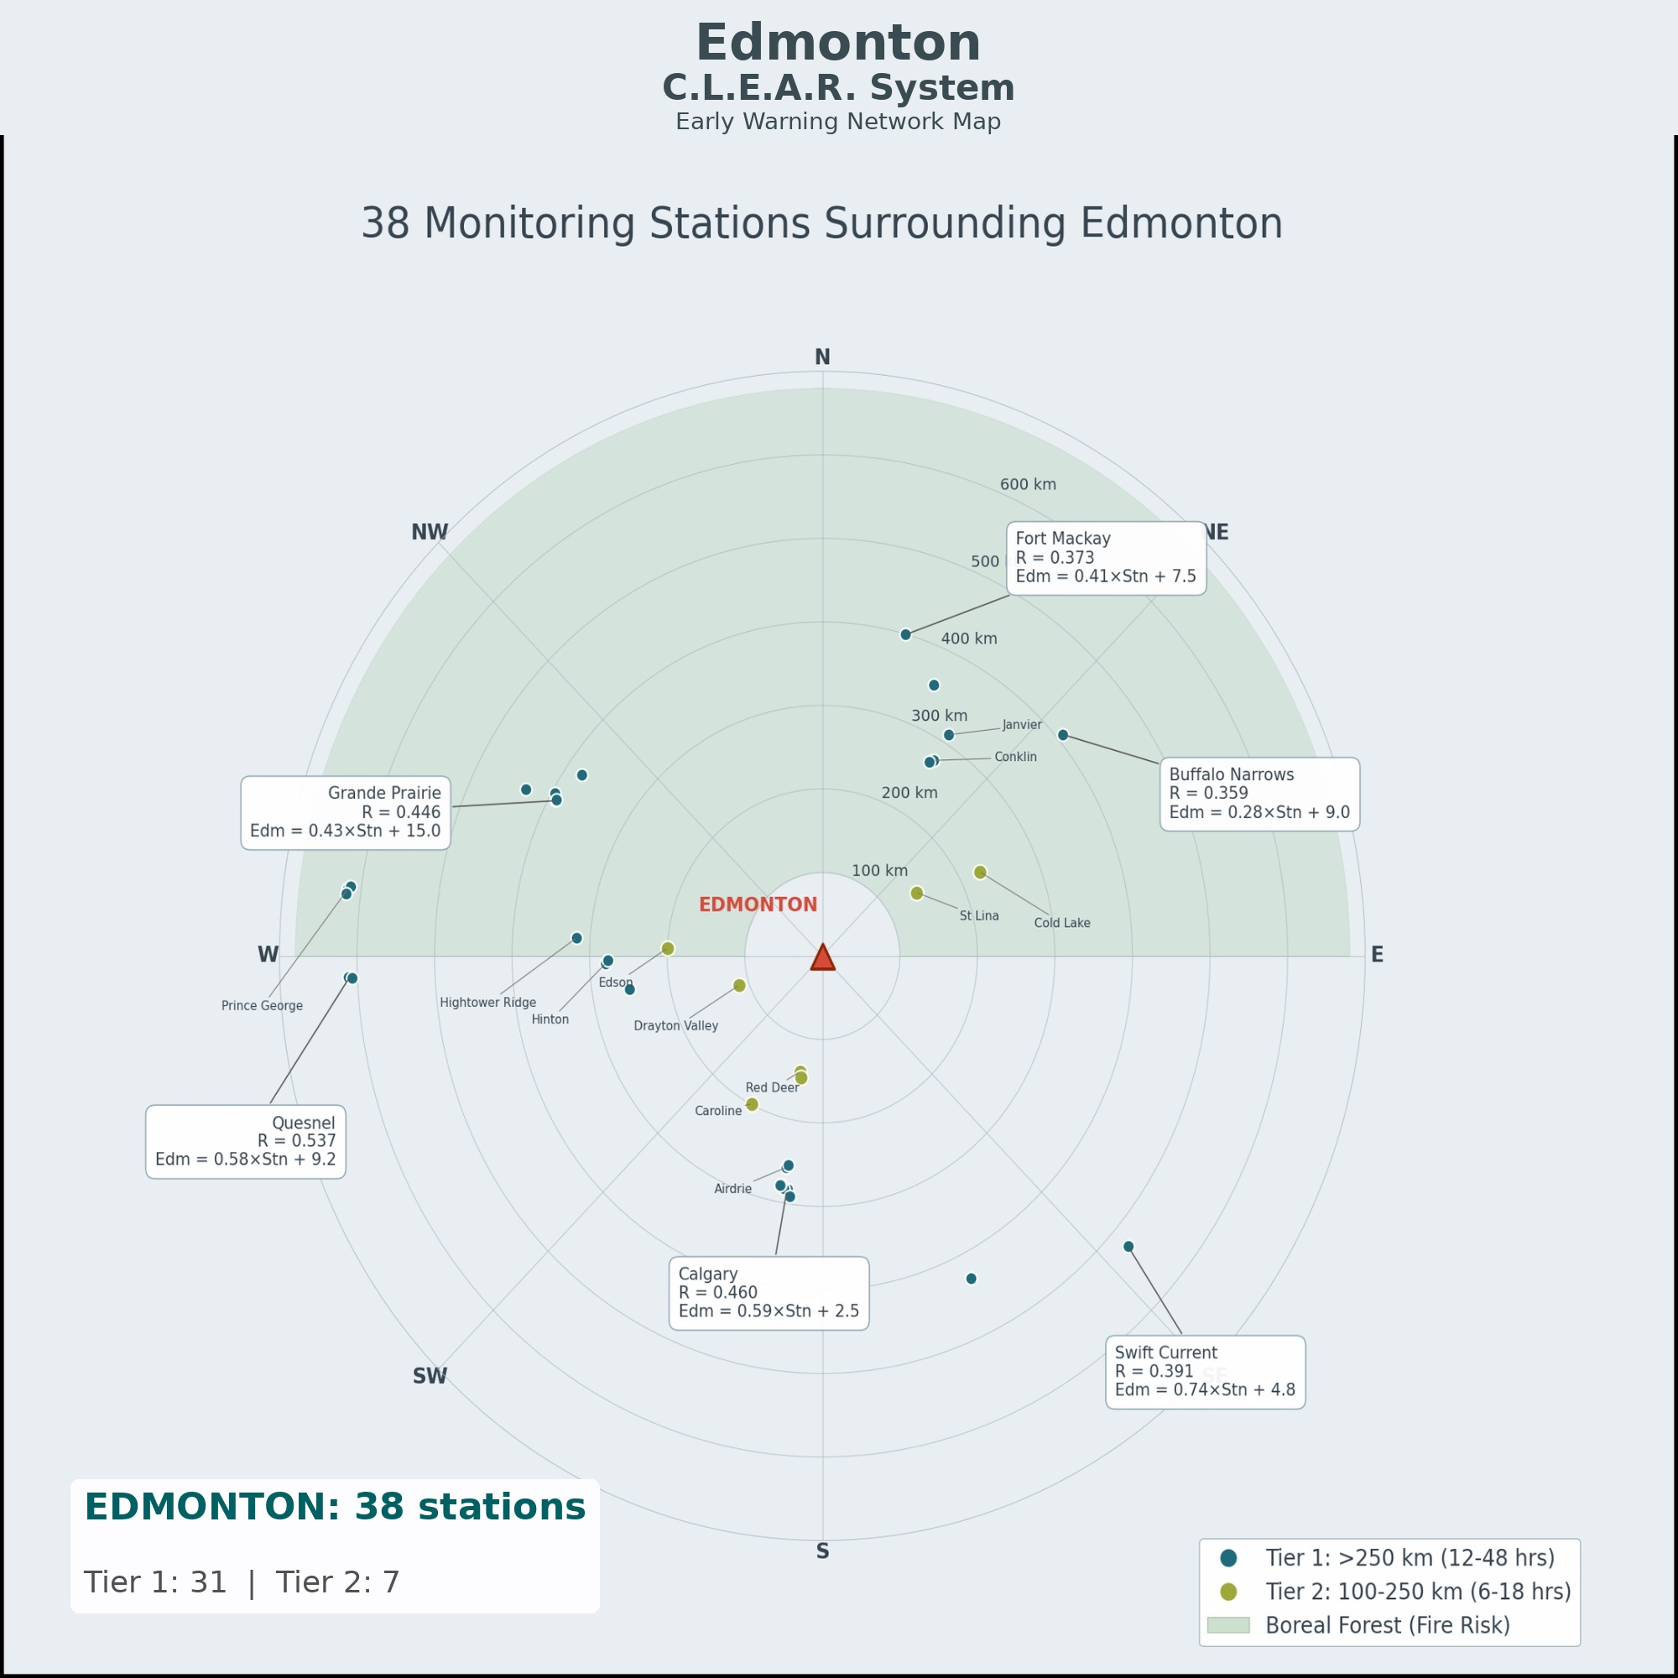
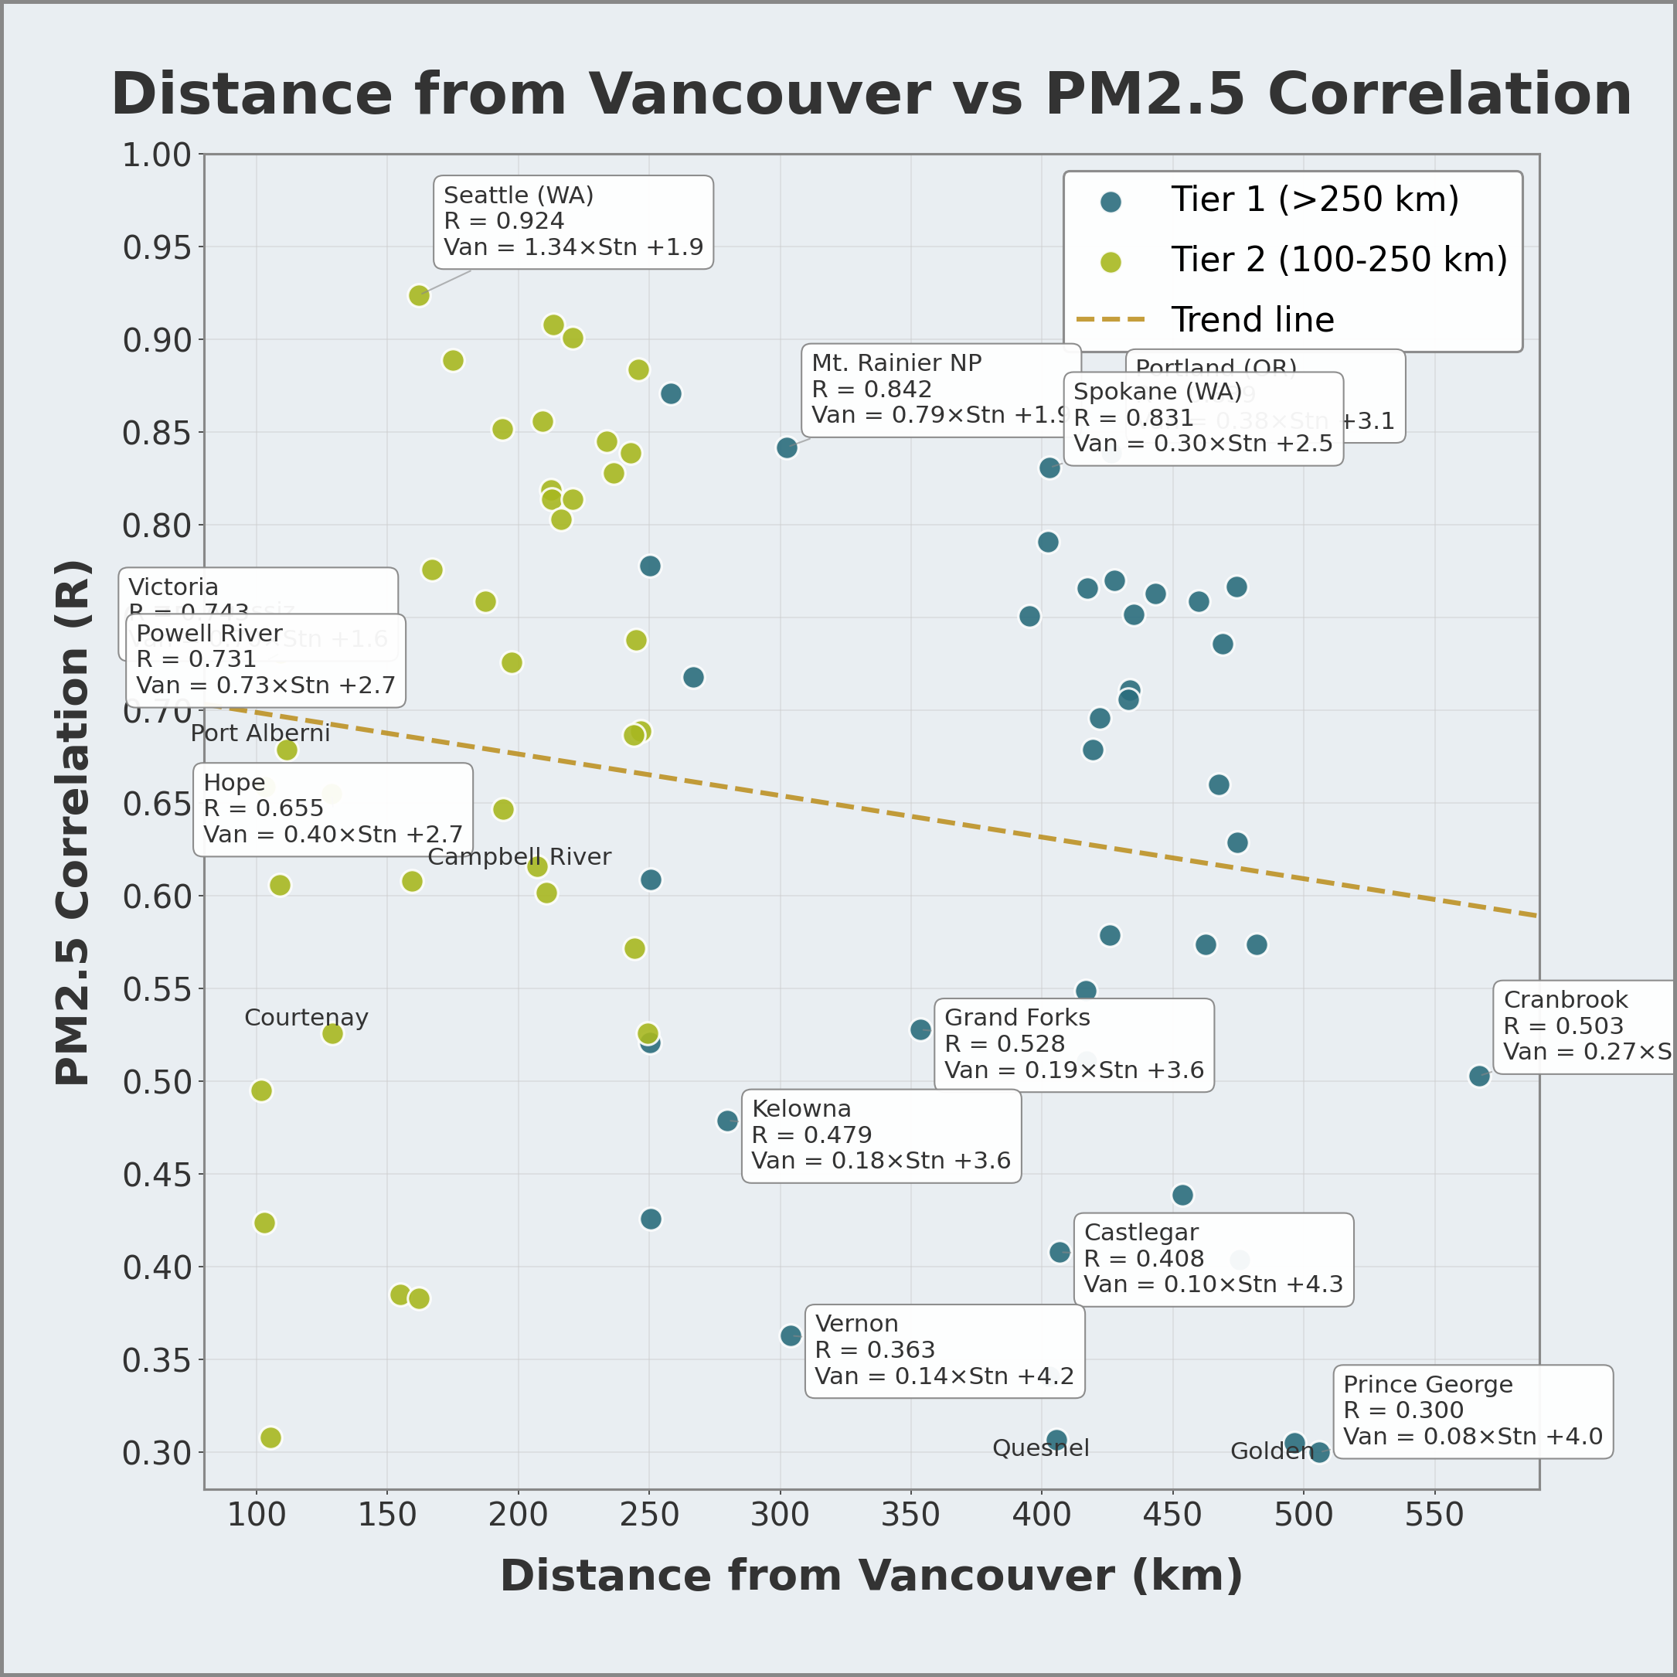
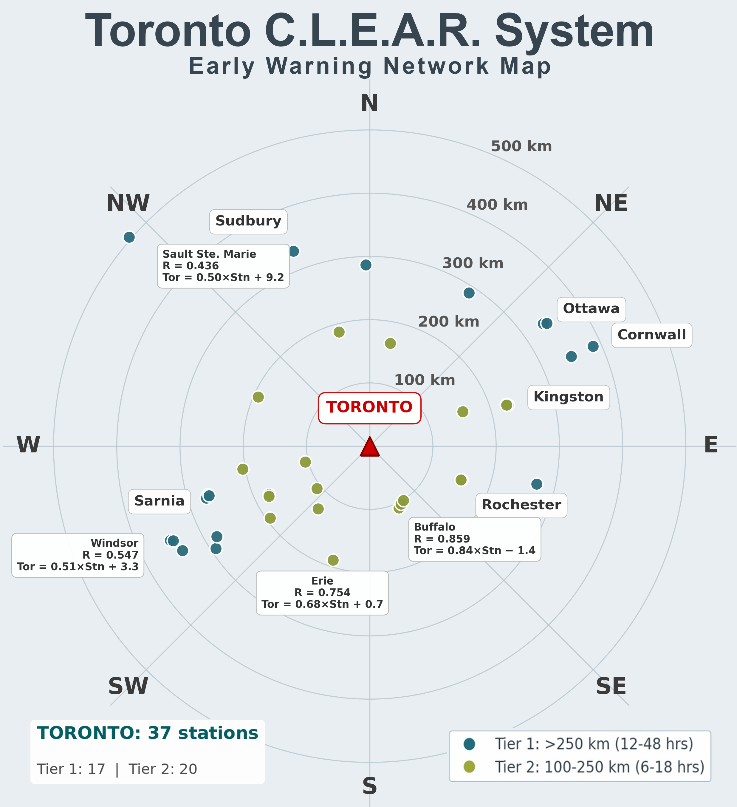
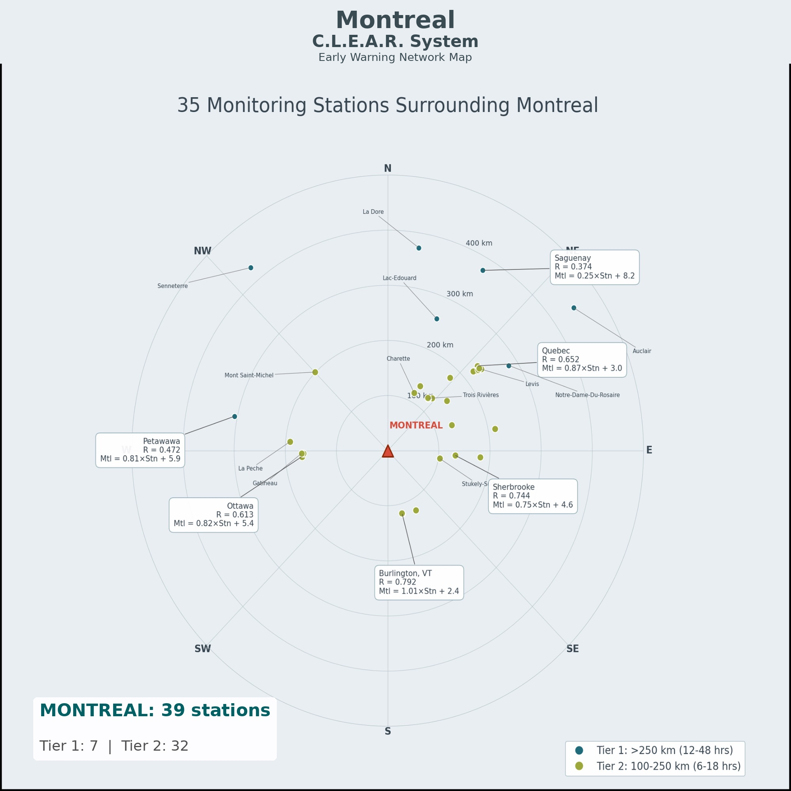
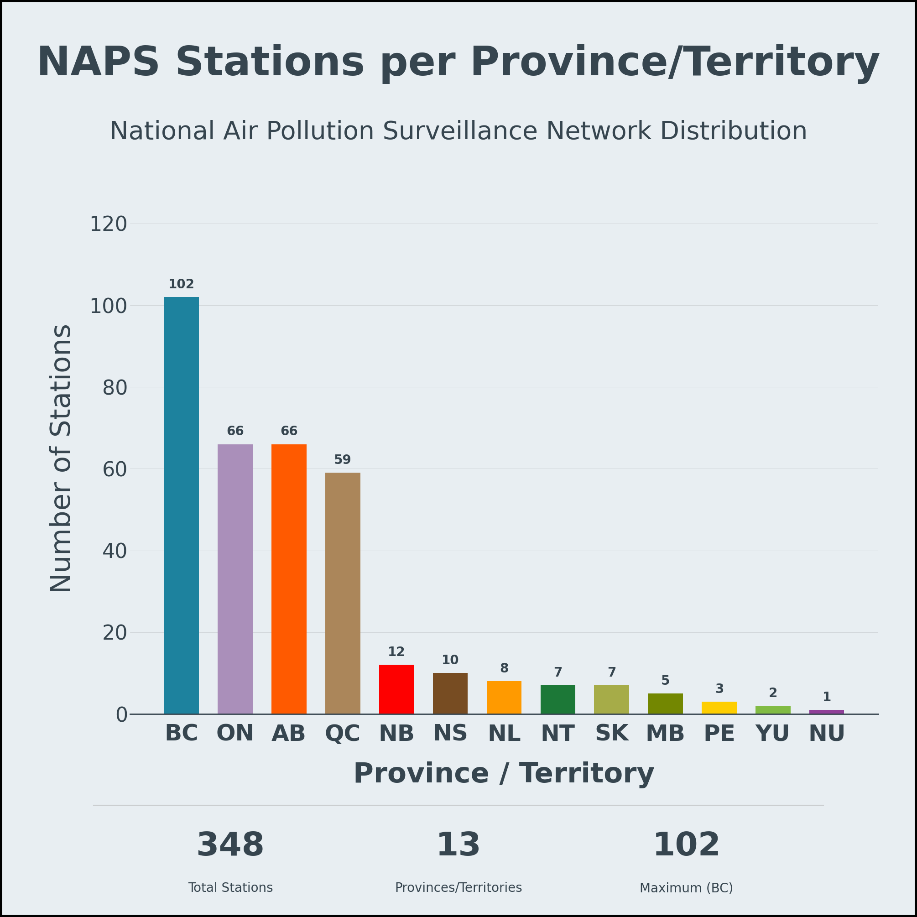
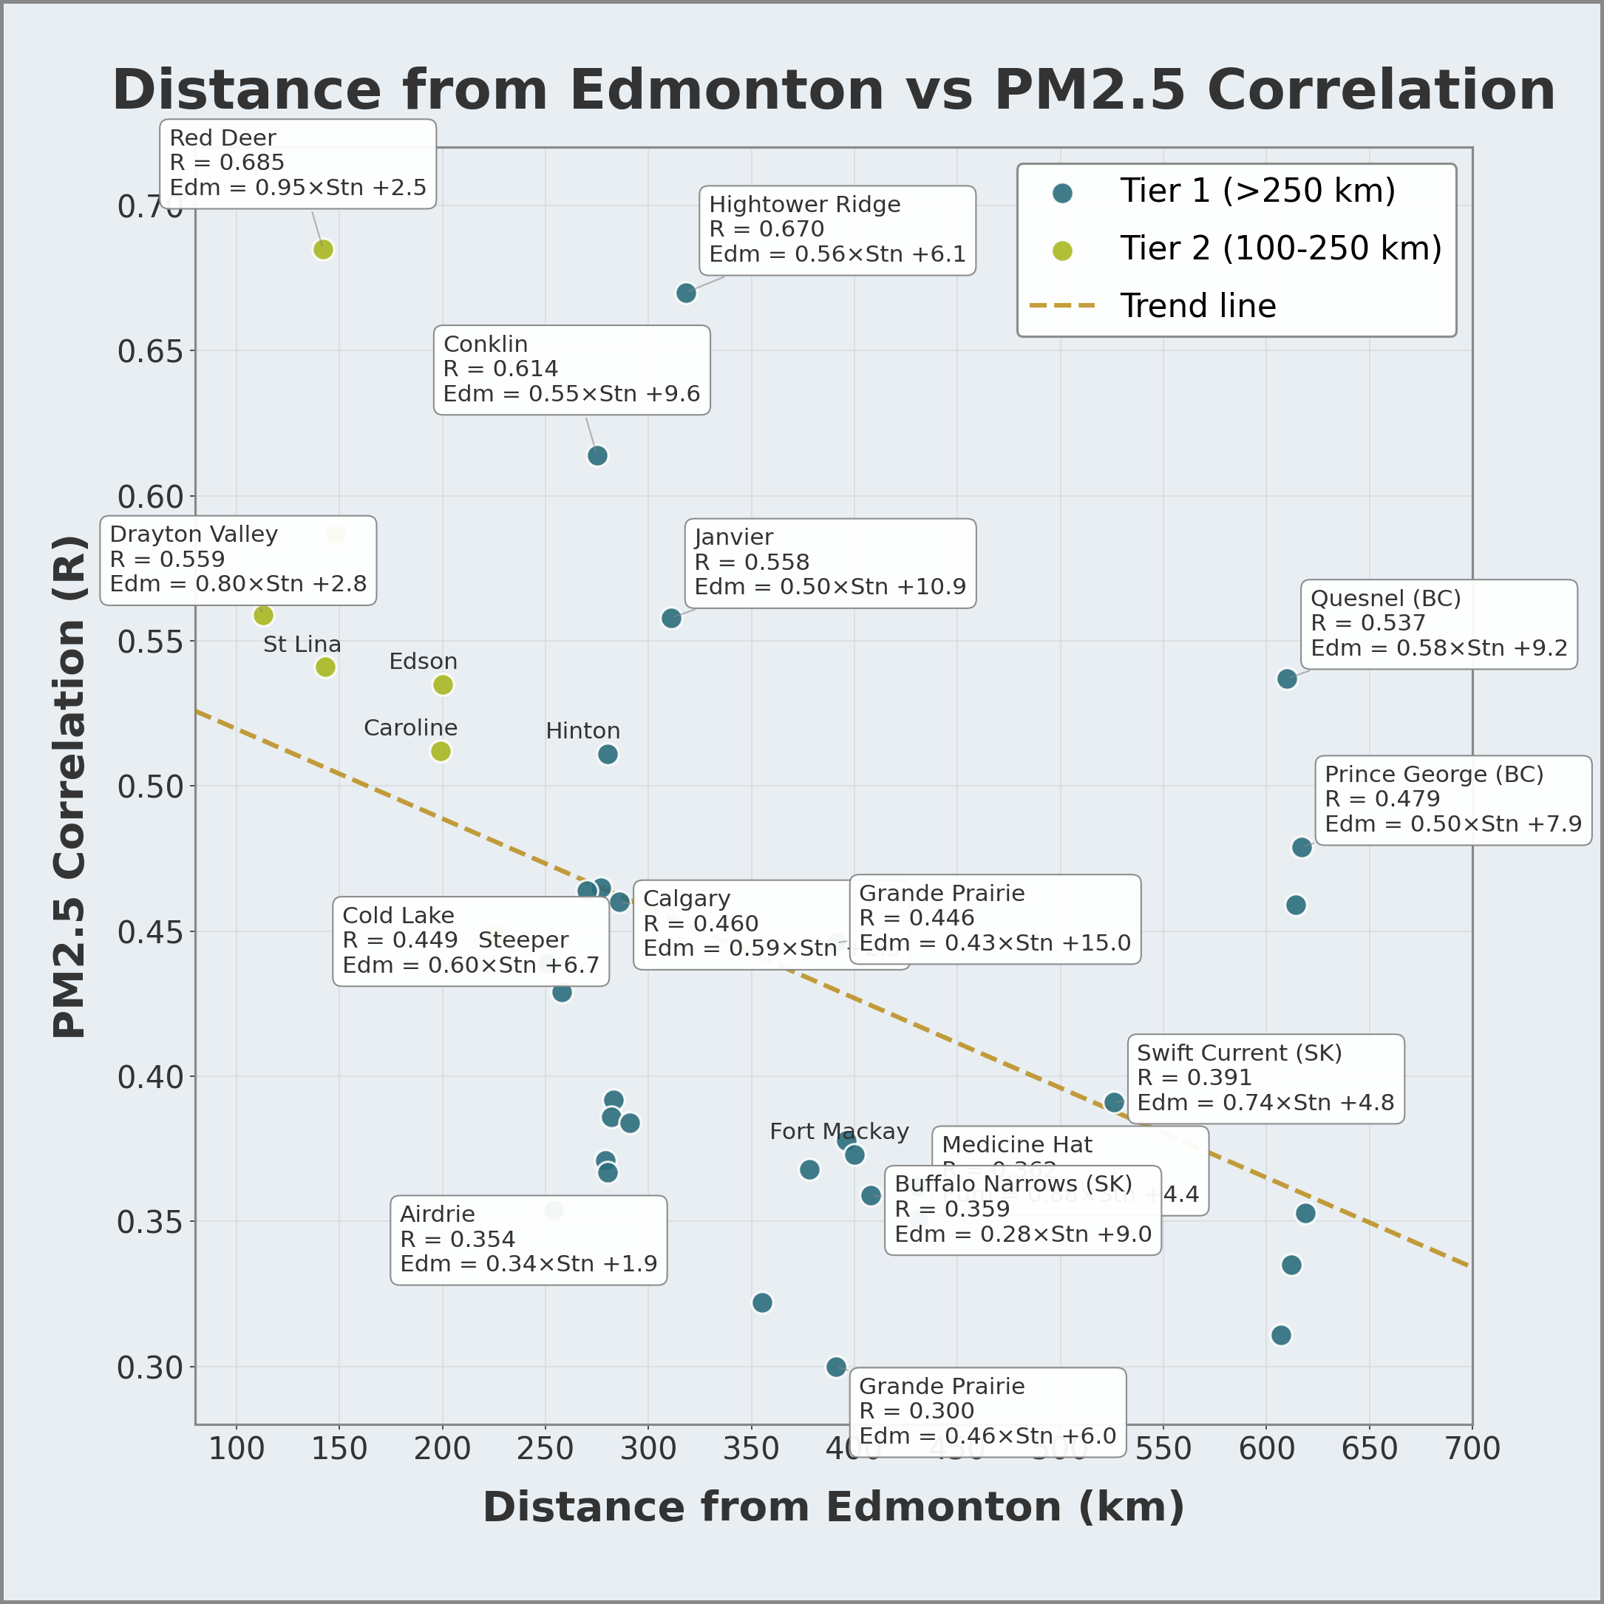
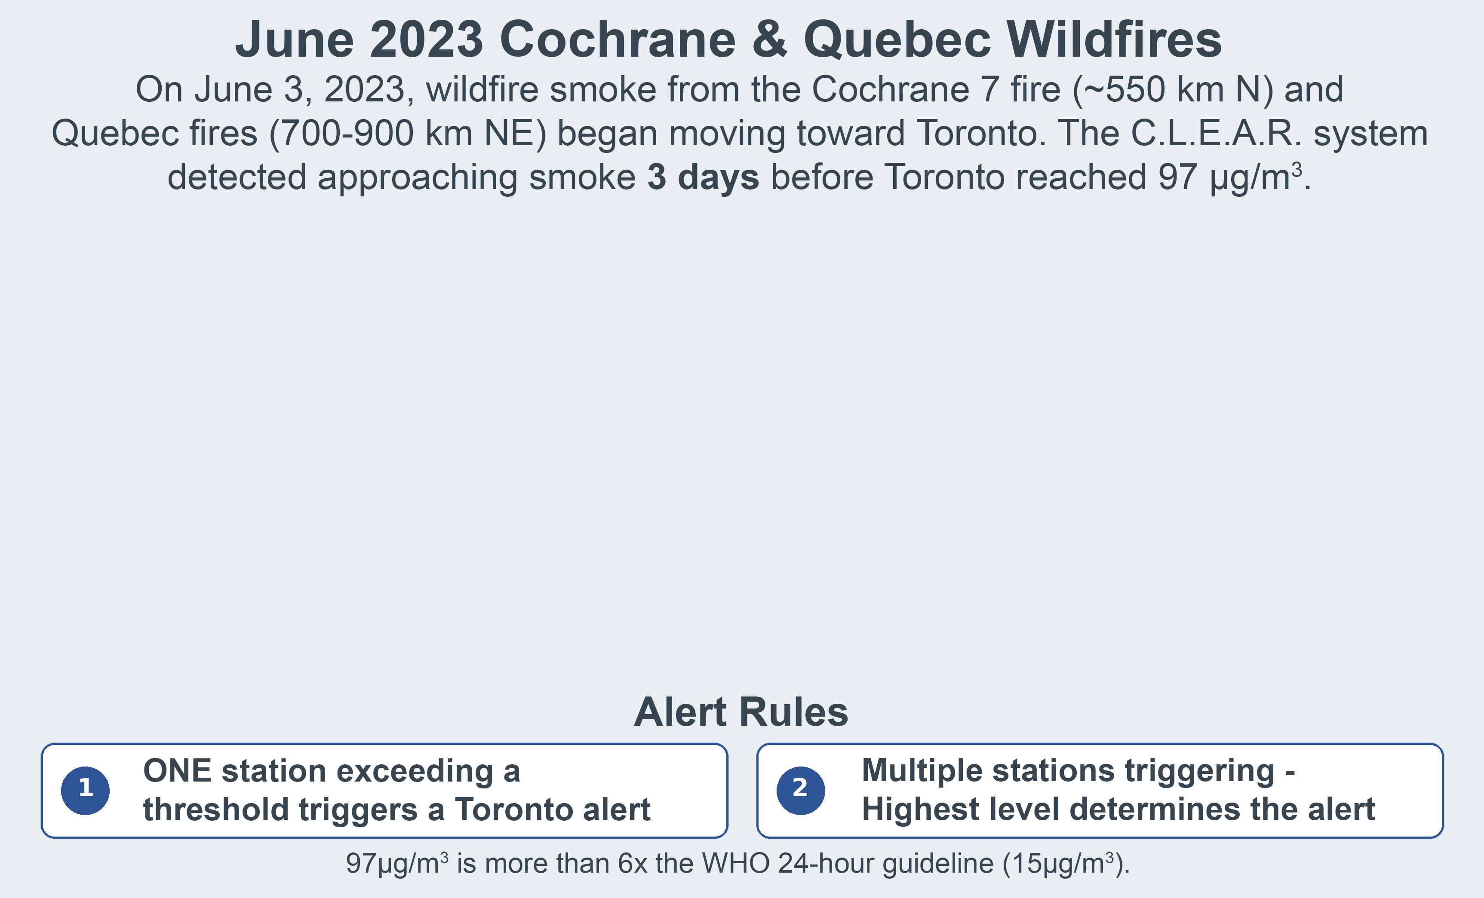
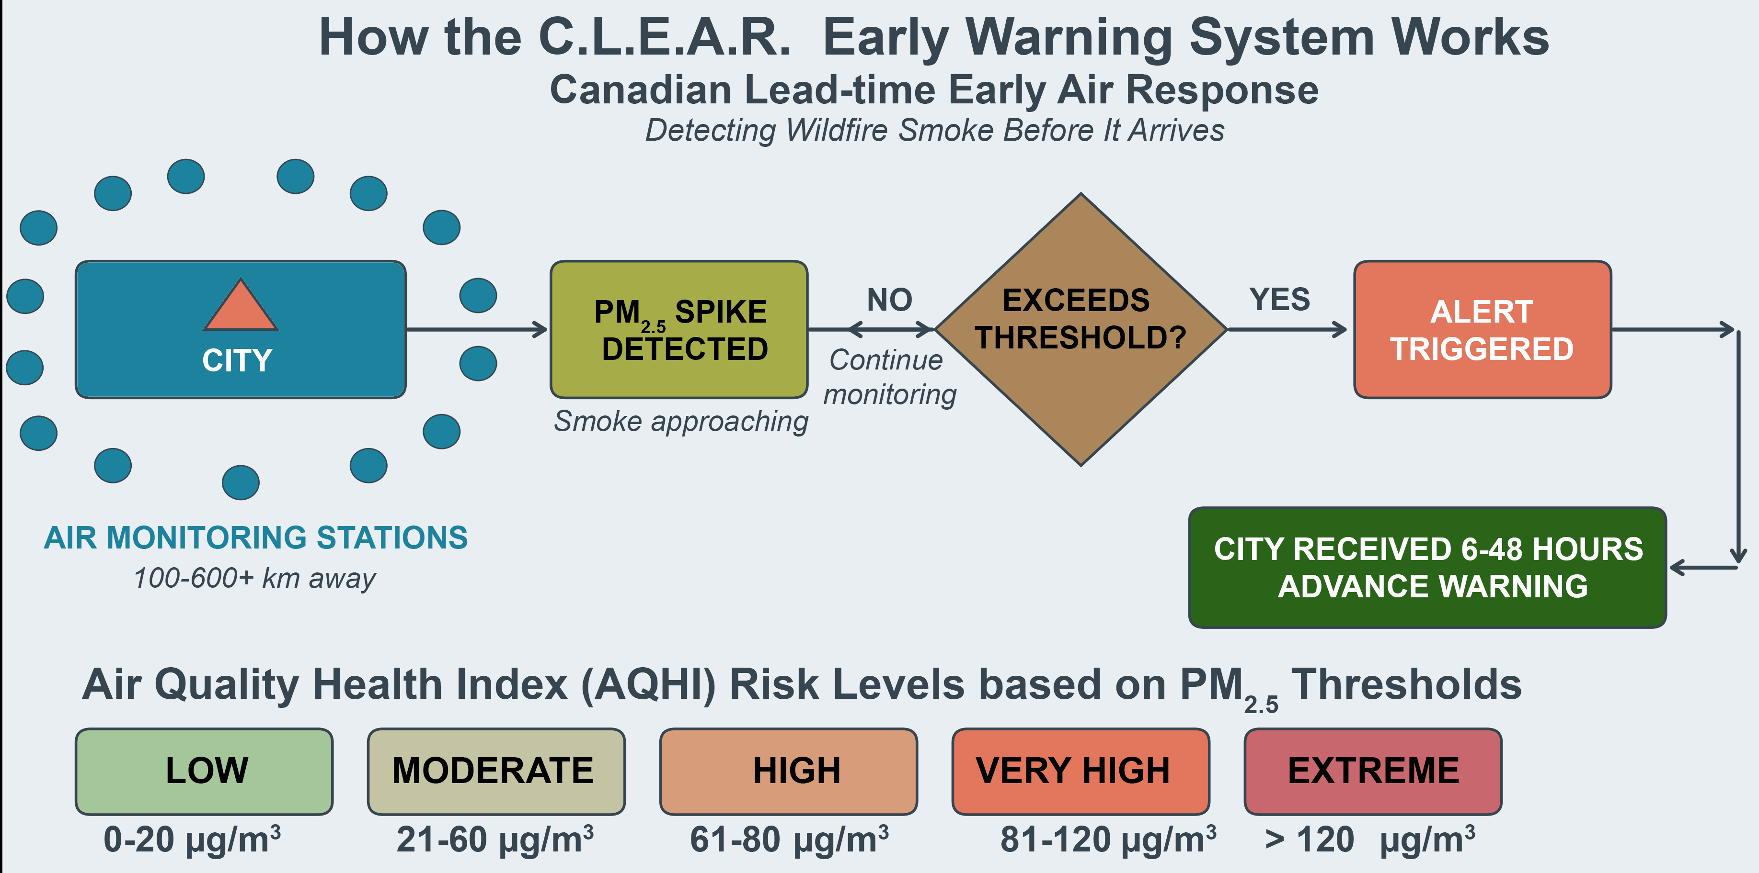
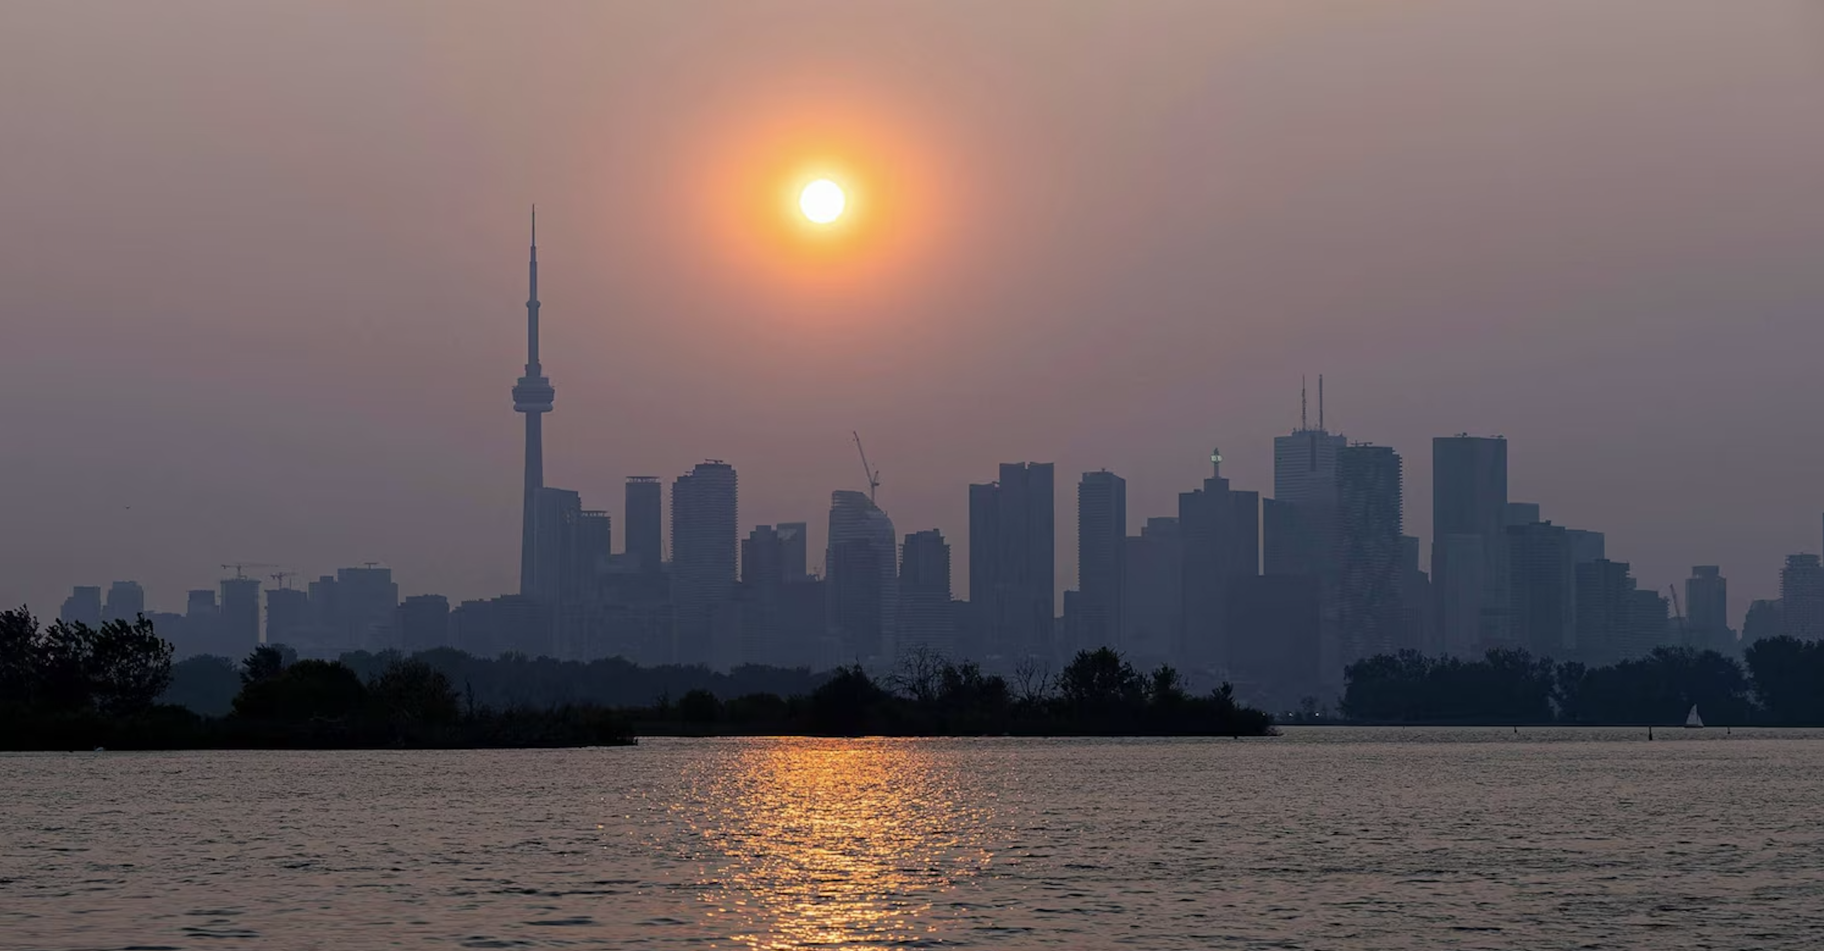
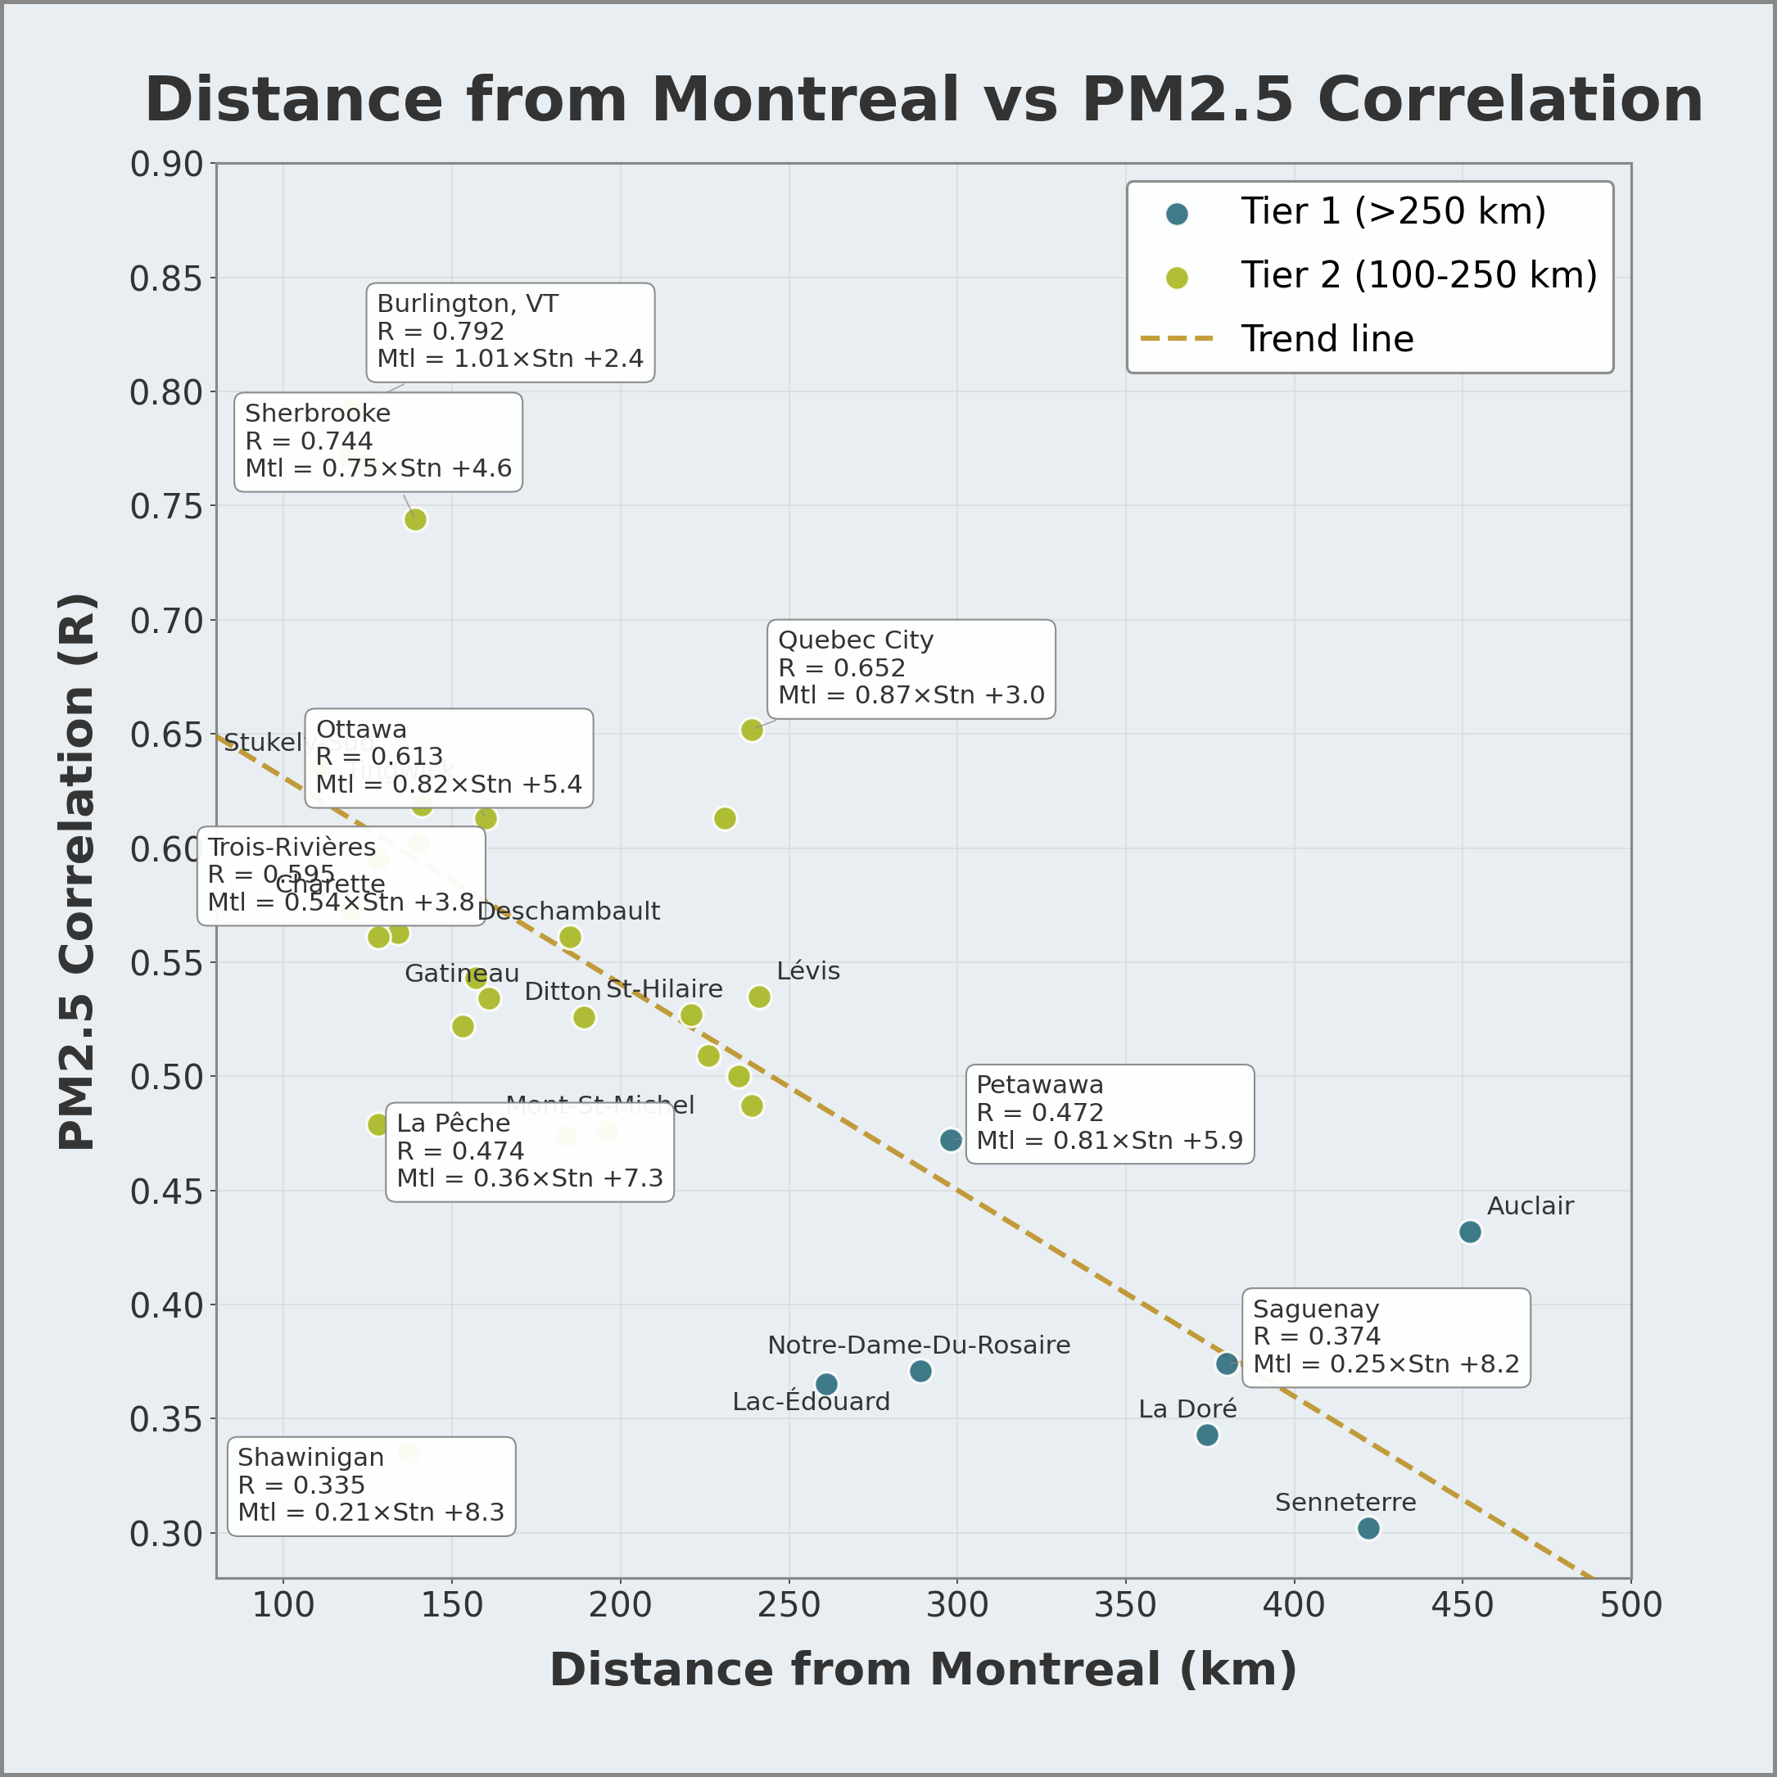
Purpose
Forest Fire Burn Area Analysis
AI Platform Validation
Wildfire activity is increasing across Canada, with a statistically significant increase in burned area nationally and in British Columbia, Alberta, Saskatchewan, and the Northwest Territories
Long-range smoke transport leads to elevated PM_{2.5} levels that pose serious respiratory and cardiovascular health risks.
Currently, major cities often receive little advance warning before smoke arrives.
This project developed the C.L.E.A.R early-warning system to predict wildfire-related PM_{2.5} spikes in Toronto, Edmonton, Montreal, and Vancouver by detecting smoke at distant air-quality monitoring stations (100-600+ km away), providing 6-48+ hours of advance warning (depending on station distance)
This system could allow schools, hospitals, and municipalities to act before air quality deteriorates
Identical Linear Regression Analysis on 36M+ Observations
Claude
Anthropic
ChatGPT
OpenAI
Gemini
Google
Julius AI
☑️ Mathematically Equivalent Results
All four platforms produced matching core statistical values
Key Finding
Analysis is independent of the Al platform used
Manual Verification
Hand calculations on sample data confirmed
Al-generated results
Cross-platform validation ensures scientific reproducibility and transparency
Research Question
Figure 3: Statistically significant increases in burn area were identified, supporting the need for an early-warning PM_{2.5} alert system. Data source: National Forestry Database, Natural Resources Canada (2025). Regression analysis and visualization generated with Claude AI (Anthropic).
Historical Validation
Can hourly PM_{2.5} measurements at distant air-quality stations accurately predict PM_{2.5} levels in major Canadian cities with enough lead time to issue early warnings for wildfire smoke events?
The C.L.E.A.R System: The NAPS Early Warning Station Network
City | True Positive | False Negative | True Negative | False Positive | Detection | False Alarm | Status
Vancouver | 14 | 0 | 10 | 0 | 100% | 0% | Perfect
Edmonton | 9 | 1 | 5 | 0 | 90% | 0% | 1 Failure
Toronto | 10 | 0 | 10 | 0 | 100% | 0% | Perfect
Montreal | 14 | 0 | 10 | 0 | 100% | 0% | Perfect
Total | 47 | 1 | 35 | 0 | 97.9% | 0% | 83 events
Data Sources
Table 2: Confusion matrix results for the PM_{2.5} Early Warning System, validated using 83 historical wildfire smoke events (2003-2023). Table created with PowerPoint.
An “event” is defined as a city-level smoke impact; a single wildfire may affect multiple cities.
NAPS (Canada) and U.S. EPA AQS/AirNow, 2003-2023
Study period:
2003: start of modern PM_{2.5} monitoring
2023: most recent validated data (Environment and Climate Change Canada)
Near-Perfect Validation
47 of 48 smoke events (97.9%)
successfully detected
Methods
Zero False Alarms
All 35 non-impact forest fires
received NO warning
Correlation Analysis
Statistical correlations were calculated between target cities and distant monitoring stations during wildfire season (May-September) to isolate wildfire smoke and exclude non-wildfire PM_{2.5} sources
Regression Model
Target city PM_{2.5} = Slope x Station PM_{2.5} + intercept
Why hourly data?
Wildfire smoke travels 30-50 km/hr → early detection requires hourly PM_{2.5}
Lower correlations reflect short-term variability, not reduced predictive value
Station selection criteria
Stations were included only if ALL criteria were met:
Correlation (R) ≥ 0.30
Significance (P) < 0.001
Sample Size (N) ≥ 100
Early Warning System
Identified 218 monitoring stations providing 6-48+ hours of advance warning
Alert thresholds calculated using the WHO PM_{2.5} health guidelines
Built a 360° early warning network around each city
Validated using historical wildfire events
Computational Analysis
Large-scale data analysis of 36+ million hourly PM_{2.5} observations was performed using Claude AI (Anthropic)
Edmonton Failure Analysis
One event (449 ug/m³) missed due to gap in NNW monitoring coverage
This failure demonstrates that network gaps, not model limitations, are the primary risk
Recommend additional monitoring stations:
Jarvie (107 km NNW): Tier 2 coverage
Athabasca (145 km N): Tier 2 northern coverage
Whitecourt (175 km WNW): Tier 2 improved western boreal coverage
Slave Lake (250 km N): Tier 1 coverage from the Peace region
Figure 4: Scatter plot shows the relationship between station distance from the target city and PM_{2.5} correlation strength (R). Correlation decreases with distance but remains sufficient for early warning. Data source: NAPS Program, Environment and Climate Change Canada. Regression analysis and visualization generated with Claude AI (Anthropic).
Figure 6: Vancouver C.L.E.A.R. system. Image by Claude AI.
2024 Data Validation
Figure 5: Vancouver C.L.E.A.R. system. Image by Claude AI.
Real-Time Automated C.L.E.A.R. Alert System
National Air Pollution Surveillance (NAPS)
Created a C.L.E.A.R. APP for incorporating real-time wind direction and speed data to improve prediction accuracy.
The National Air Pollution Surveillance (NAPS) Program is Canada’s national air-quality monitoring network, operated by Environment and Climate Change Canada
Measures: PM_{2.5}, Ozone (O₃), nitrogen dioxide (NO₂), sulfur dioxide (SO₂).
84% of stations are located in BC, AB, ON, and QC, providing dense regional coverage.
High station density allows wildfire smoke to be detected hundreds of kilometres upstream before it reaches major cities
Vancouver, Edmonton, Toronto, and Montreal were selected because their surrounding monitoring networks provide sufficient spatial coverage to enable advanced smoke detection and early warning
Figure 7: Edmonton C.L.E.A.R. system. Image by Claude AI.
Wildfire smoke over the Toronto skyline, June 6, 2023.
Zou Zheng/Xinhua via Newscom.
Our system could have provided a 6- 48 hours warning before this happened.
Conclusion
Novel Contribution: This project demonstrates for the first time that Canada's existing NAPS monitoring network can be repurposed as a predictive early warning system for wildfire smoke, requiring no new infrastructure, only data integration.
Proven Reliability: Historical validation across 21 years achieved 97.9% detection accuracy with zero false alarms, providing 6–48 hours of advance warning for major Canadian cities.
Actionable Results: The C.L.E.A.R. system could give schools, hospitals, and municipalities critical lead time to protect vulnerable populations before hazardous smoke arrives.
Scalable Solution: This methodology can be applied to any city with sufficient surrounding monitoring stations, making it adaptable across Canada and internationally.
Climate Urgency: With wildfire activity projected to increase, early warning systems are no longer optional—they are essential public health infrastructure.
Figure 5: Air monitoring stations surrounding each city at varying distances provide 360° early-warning coverage, detecting smoke regardless of wind directions. Map generated with Claude AI (Anthropic).
Figure 8: Montreal C.L.E.A.R. system. Image by Claude AI.
How the C.L.E.A.R. Early Warning System Works: A Real Example
Future Work
Figure 1: National Air Pollution Surveillance (NAPS) Program. Visualization generated using Claude AI (Anthropic).
Alert Level | PM_{2.5} Level | Public Health Action Plan
Low | < 20 ug/m³ | No precautions needed.
Moderate | 21-60 ug/m³ | Sensitive groups (children/elderly) avoid strenuous activities.
High | 61-80 ug/m³ | Everyone should reduce physical exertion. N95 or KN95 mask. Keep doors and windows closed. HVAC to recirculate. Run HEPA filter.
Very High | 81-120 ug/m³ | Avoid all outdoor activity. Keep hydrated.
Extreme | > 120 ug/m³ | Halt indoor pollution. No frying or sauteing. No vacuuming. No candles. No wood-burning stoves.
Integrate satellite smoke detection data for longer-range warning.
Expand to additional Canadian cities.
Test system performance during actual smoke events.
Advocate for expanded NAPS coverage in Saskatchewan, Manitoba and the Northwest Territories.
System Flowchart
Date | Station | Distance | PM_{2.5} Reading | Threshold | Alert Triggered
June 3 | Parry Sound | 187 km NNW | 196 µg/m³ | > 139.3 µg/m³ | Emergency
June 6 | Cornwall | 387 km ENE | 160 µg/m³ | > 99.3 µg/m³ | Alert
June 6 | Toronto | - | 97 µg/m³ | (Actual) | Alert
Data Sources and Acknowledgements
Table 1: The early warning system alert scale and recommendations. Table created with PowerPoint.
Toronto schools could have had 3 days to cancel outdoor activities before air quality reached hazardous levels on June 6, 2023.
Anthropic. (2026). Claude AI (Version 3.5 Sonnet) [Large language model]. https://claude.ai
Cruz, M. G., Alexander, M. E., & Sullivan, A. L. (2019). Toward a model for estimating fire spread rate in seasonally dormant grasslands and shrublands. Annals of Forest Science, 76(2), Article 44. https://doi.org/10.1007/s13595-019-0829-8
Environment and Climate Change Canada. (n.d.-b). National Air Pollution Surveillance (NAPS) Program. Government of Canada. https://www.canada.ca/en/environment-climatechange/services/air-pollution/monitoring-networks-data/national-air-pollutionprogram.html
Environment and Climate Change Canada. (n.d.-c). PM2.5 data portal: National Air Pollution Surveillance (NAPS) Program. Government of Canada. https://datadonnees.az.ec.gc.ca/data/air/monitor/national-air-pollution-surveillance-napsprogram/Data-Donnees?lang=en
Environment and Climate Change Canada. (n.d.-d). Representative Concentration Pathways. Government of Canada. https://climate-scenarios.canada.ca/?page=scen-rcp
IQAir. (2021). WHO air quality guidelines. https://www.iqair.com/ca/newsroom/2021-who-airquality-Guidelines
National Forestry Database of Canada. (n.d.). Forest fires. Canadian Council of Forest Ministers. http://nfdp.ccfm.org/en/data/fires.php#tab323
United States Environmental Protection Agency. (n.d.). Air quality data: Download daily data. https://www.epa.gov/outdoor-air-quality-data/download-daily-data
Notes on AI Tool Usage
Claude AI (Anthropic, 2026) was used for the following components of this research project:
Large-scale data processing of 36+ million hourly PM₂.₅ observations from the NAPS and US EPA databases
Linear regression analysis for 445 monitoring stations across Canada and the United States
Generation of data visualizations, including maps, scatter plots, and trend analyses
Cross-platform validation was performed using four independent AI platforms (Claude, ChatGPT, Gemini, and Jules) to confirm reproducibility of statistical results
Figure 9: Example of C.L.E.A.R. early warning system. Visualization created with PowerPoint and Adobe Photoshop.
Figure 2: Correlation of PM2.5 Concentrations with Canadian AQHI Risk Levels. This chart synthesizes the PM_{2.5} concentration breakpoints used in AQHI-Plus wildfire amendment (Yao et al., 2019) with national safety benchmarks (CCME, 2023) and global health guidelines (WHO, 2021). Risk categories and indoor recommendations are derived from Health Canada’s residential air quality framework. The visualization was created using Adobe Photoshop.
The World Health Organization PM_{2.5}
Air Quality Guidelines (AQGs):
Annual: 5 ug/m³
24-hour: 15 ug/m³
Image 1: Wildfire smoke over the Toronto skyline, June 6, 2023. CLEAR could have provided 3 days' advanced warning. Photograph by Zou Zheng/Xinhua via Newscom.

